Slide 1

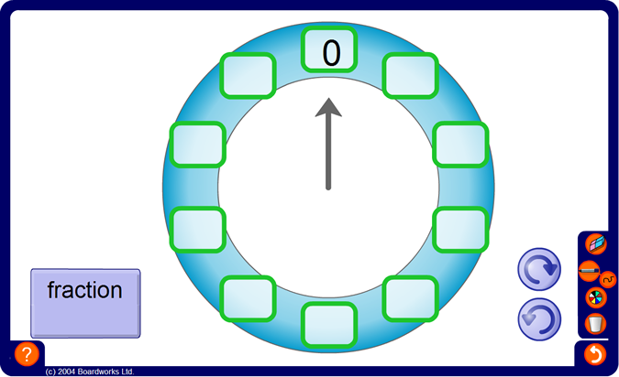
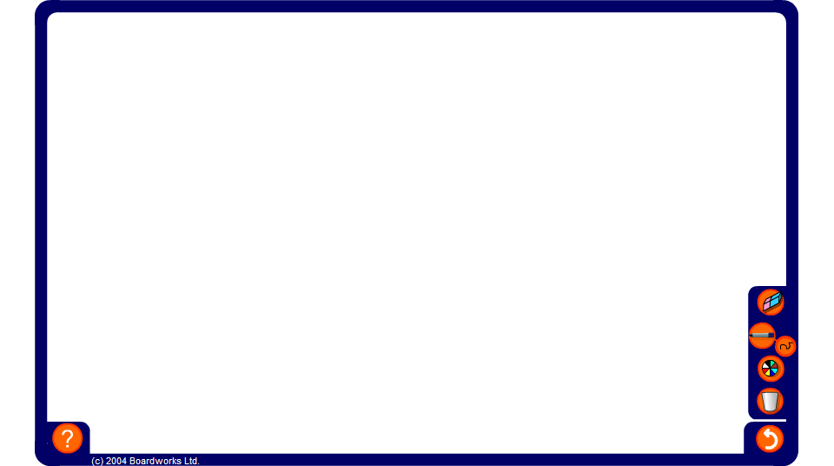


Counting on and back using fractions
Notes:
Spend some time counting on and back using fractions. Start with unit fractions such as ¹/₄ and ¹/₈ and progress to other proper fractions such as ³/₄.
Ask pupils how we could use the counter to work out, say, 10 × ¹/₃.
Demonstrate, using the counter, that 10 × ¹/₃ is 3¹/₃.
Establish that ¹/₃ of 10 is also 3¹/₃ and that 10 × ¹/₃ is equivalent to ¹/₃ of 10.
Tell pupils that in maths ‘of’ means the same as ‘times’. ¹/₃ of 10 is equivalent to ¹/₃ × 10 which is equivalent to 10 × ¹/₃. These calculations are also equivalent to 10 ÷ 3.
Repeat for other examples.

